Slide 1
Curriculum Mapping Overview
Adapted from A Guide to Curriculum Mapping: Creating a Collaborate, Transformative, and Learner-Centered Curriculum
Authors: Jennifer M. Harrison & Vickie Rey Williams

Slide 2
University of New Mexico
Julie Sanchez, Director of Assessment & APR
Amanda DiMercurio, APR Manager
Eva Rodriguez-Gonzalez, Spanish & Portuguese Faculty, College of Arts and Sciences
Cassie Rowe, Anderson School of Management Accreditation Specialist

Slide 3
What is a curriculum map?
Visualization of curricular relationships within one program or amongst/between all programs
Tool to inform instructors: curriculum, SLO’s, student headcount/enrollment
Tool to inform leadership: Degree alignment/gaps, resource allocation
Tool to explore areas of student success and potential improvements

Slide 4
Curriculum Mapping
Strategic Planning
Curriculum & Assessment
Institutional
Communication
Identify saturation & gaps
Quick link to faculty expertise and coverage (evidence for hiring needs)
Improve Advising Services
Marketing for Students
Increase instructor understanding how their courses are positioned
Support planning of new curriculum development
Support sequencing & flow
Simplify and elevate assessment
Creates vertical & horizontal alignment
Monitor changes across time
Support new concentrations & degrees
Inform initiatives
Support the development of interdisciplinary structures
Support accreditation
Support APR self-study

Slide 5
How does curriculum mapping benefit you?
Instructors
Program leadership
Assessment & APR
Visual tool to conceptualize, align, compare, discuss, and assess curricular data
Supports new course and degree submissions
Identify how students are struggling or thriving in program curriculum
Vital to accreditation and assessment practices that are central to institutional- and program-level assessment
Connect institutional student initiatives with program curriculum and advisement
Programmatic assessment becomes more personalized and relevant to individual programs
In APR, helps see where curriculum, assessment and strategic planning efforts can be meaningfully put
Assessment becomes integrated into teaching and learning
Build assessment culture in all parts of the assessment cycle
Introduction, pg. 6-8

Slide 6
Chapter 4, pg. 104:
Vertical Alignment
Notes:
Pg 104

Slide 7
Vertical alignment
Articulation of relationships of outcomes from:
Institutional level to
College/program/course level to
Assignment/test/activity level
Draws lines from student learning results on their assignments and courses to relevant higher-level courses
Helps connect, synthesize, and analyze data across courses and programs on multiple levels
Chapter 4, pg. 100:
Vertical Alignment
Notes:
Ch 4 p100

Slide 8
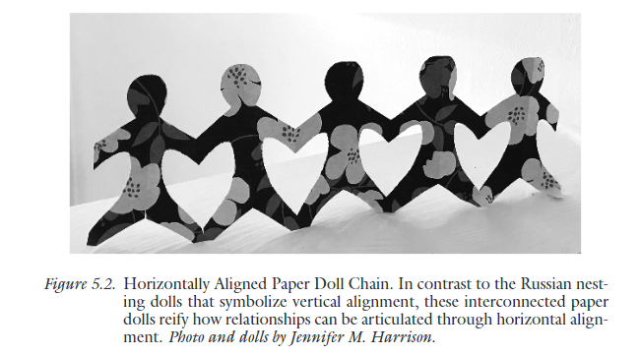
Horizontal alignment
Within and across programs and institutions
Connects learning outcomes and evidence across academic and co-curricular programs
Helps collaboration on teaching and learning innovations
Chapter 5, pg. 114, 117:
Horizontal Alignment
Notes:
Ch 5 p 114, picture is p 117

Slide 9
Curriculum map template for undergraduate degree/programs from CAS
Degree/Program SLOs | Program Goals | Core (required) Courses GenEd (1000-2000) and/or Upper-level 300-400 Courses |  |  |  | Electives and Co-curricular
 |  | 1000 | 2000 | 300 | 400 | 300 | 400 | Internship/ Community engagement
INSERT HERE SLO1
SLO2
SLO3
SLO4
SLO5

Slide 10
Curriculum map questions for undergraduate degree/programs from CAS
When proposing a new course in your UG curriculum, please answer the following questions:
1. Based on the info outlined above in the table, how many Degree/Program SLO(s) and Goal(s) the proposed course will be contributing to? Please identify such Degree/Program SLO(s) in your response. Example of response: “Proposed course will be related to Degree Program SLOs A.1 and C.2 (Goals A and C)”
2. How does the proposed course contribute to your UG Degree SLOs and Goals? Please identify at least ONE student artifact/assignment that is directly aligned to such SLO(s) identified above. Example of response: “Proposed course will include an individual paper that focuses on SLO A.1”

Slide 11
Before closing the loop
Identify signature assignments
Assignments that challenge students to integrate multiple outcomes
Create direct measure tools
Articulate how student learning evidence demonstrates outcomes
Use data on individual and collective learning
Align learning evidence
Draw a line between evidence and outcome
Chapter 6, pg. 147-148:
Using Curriculum Mapping to Close the Loop
Notes:
P 147-148

Slide 12
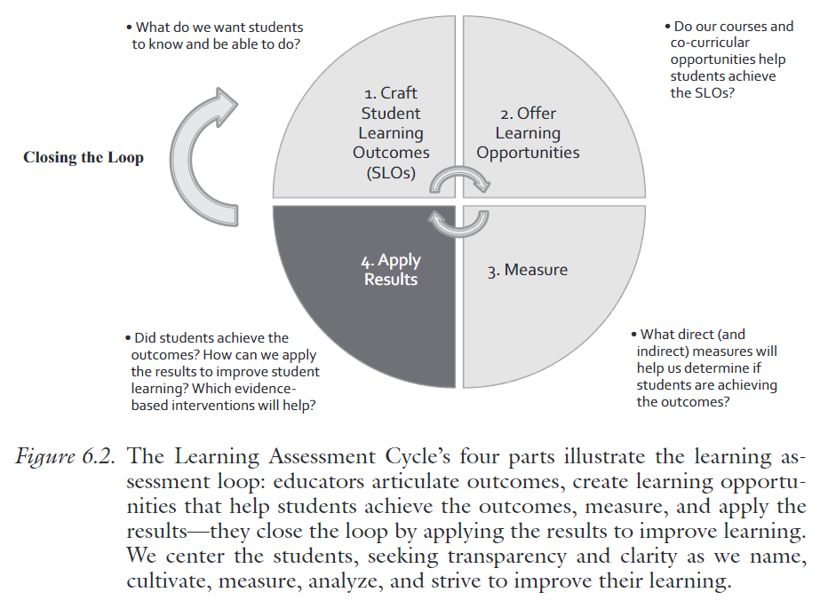
Closing the loop
Curriculum mapping makes closing the loop more effective
Contextualizes and connects interventions on closing the loop
Bridges outcomes data to analytics data, leading to more nuanced interventions on closing the loop
Curriculum mapping makes closing the loop more effective​
Contextualizes and connects interventions on closing the loop​
Bridges outcomes data to analytics data, leading to more nuanced interventions on closing the loop​
Chapter 6, pg. 142, 145, 182:
Using Curriculum Mapping to Close the Loop
Notes:
Ch 6 p142, 182

Slide 13
After closing the loop
Revising and streamlining the assessment loop
As you close the loop, you may find ways to streamline your assessment process
Clarifying and realigning outcomes
Use students to further refine, articulate, and clarify your student learning outcomes
Uncovering hidden learning outcomes
Student learning that’s already taking place and expressed through mission and vision, but not operationalized in institutional-level outcomes
Filling gaps with opportunities, revising assignment and measures, and analyzing in context and comparison
Identify campus partnerships/resources that can support you
Chapter 6, pg. 160-162, 167:
Using Curriculum Mapping to Close the Loop
Notes:
160-162, 167

Slide 14
Example curriculum map from ASM (MSPM)
 |  | Goal 1: Apply core concepts of project management. |  | Goal 2: Apply analytical methods relevant to specific project management challenges and scenarios. | Goal 3: Employ project management metrics in diverse business contexts.
 |  | 1.1: Students will be able to distinguish between technical and managerial concepts as they relate to project management. | 1.2: Students will be able to critically analyze project management issues through data analysis in the project-management decision making process. | 2.1 Students will be able to adapt effective solutions for project and program management issues in diverse often technically intensive business sectors. | 3.1: Students will be able to assess program outcomes and objectives for project decision-making and interactions with stakeholders. | 3.2: Students will be able to evaluate project management team performance.
Course # | Title | Foundational Knowledge | Critical Thinking | Problem Solutions | Strategic Decision-Making | Teamwork
MGMT 401 | Intro Project Management | X |  | X |  | X
MGMT 515 | Innovative Product Development |  | X | X | X
MGMT 517 | Technology Program Management |  | X |  | X
MGMT 519 | Project in Technology Commercialization |  | X | X |  | X
MGMT 526 | Financial Decision Making |  | X | X | X
MGMT 529 | Fundamentals of Project Management | X |  |  | X | X
MGMT 530 | Advanced Project Management Techniques |  | X | X | X
MGMT 533 | Analysis Tools for Managers | X |  | X | X

Slide 15
Example curriculum map from ASM (BBA)
 |  | Goal 1: Students will analyze broad business concepts and principles. | Goal 2: Students will evaluate business challenges and opportunities in diverse settings and contexts. | Goal 3: Students will model business professionalism in various contexts.
 |  | 1.1 Students will differentiate fundamental business concepts and terms across disciplines. | 2.1 Students will assess business processes and outcomes in connection with current environmental, cultural, and global issues. | 3.1 Students will communicate management concepts, plans, and decisions in effective oral presentations. | 3.2 Students will communicate management concepts, plans, and decisions in effective written reports. | 3.3 Students will collaborate effectively within teams.
Course # | Title | Core | Critical Thinking /Global | Oral Communication | Written Communication | Teamwork
ACCT 2120 | Principles of Accounting II | X | X
MGMT 300 | Operations Management | X | X
MGMT 306 | Organizational Behavior and Diversity | X |  |  | X | X
MGMT 308 | Ethical, Political , and Social Environment | X | X |  |  | X
MGMT 310 | Legal Issues for Managers | X | X |  | X
MGMT 322 | Marketing Management | X | X |  | X
MGMT 326 | Financial Management | X | X |  | X
MGMT 328 | International Management | X | X | X | X | X
MGMT 398 | Career Management Skills |  |  | X | X
MGMT 450 | Computer Based Information Systems | X
MGMT 498 | Strategic Management | X | X | X

Slide 16
Example curriculum map from ASM (MSCBA)
 |  | Goal 1: Students will demonstrate fundamental knowledge in cybersecurity and business analytics. |  | Goal 2: Students will analyze issues related to cybersecurity and business analytics. |  | Goal 3: Students will critically evaluate cybersecurity and business analytic solutions
 |  | 1.1 Students will develop solutions for strategic, tactical, and operational problems | 1.2 Students will apply knowledge of core concepts in cybersecurity and business analytics in both technical and management domains | 2.1: Students will implement technical and analytical solutions in cybersecurity and information assurance contexts. | 2.2: Students will solve issues by using the correct current technologies. | 3.1: Students will critique recommendations cybersecurity and business analytic scenarios.
635 | Data Analytics | X | X |  | X
636 | Information Systems Security |  | X | X |  | X
637 | Database Management Systems | X

Slide 17
Static visual of Curriculum Mapping for the ASM MBA

Slide 18
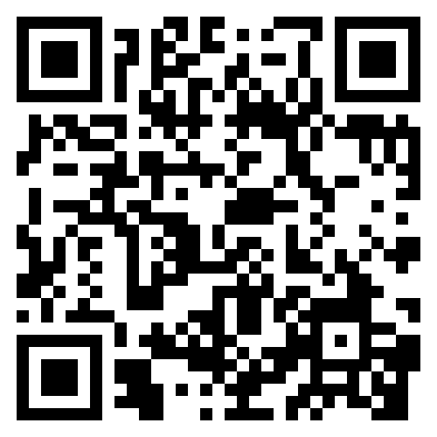
Contact us: assess@unm.edu apr@unm.edu evarg@unm.edu crowe8@unm.edu
Let us know if you are interested in a one-day mapping institute:

Slide 19
Curriculum Mapping Walkthrough
Julie Sanchez, Director of Assessment & APR
Amanda DiMercurio, APR Manager
Eva Rodriguez-Gonzalez, Spanish & Portuguese faculty
Cassie Rowe, Anderson School of Management Accreditation

Slide 20
What is a curriculum map?
Visualization of curricular relationships within one program or amongst/between all programs
Tool to inform instructors: curriculum, SLO’s, student headcount/enrollment
Tool to inform leadership: Degree alignment/gaps, resource allocation
Tool to explore areas of student success and potential improvements

Slide 21
Curriculum Mapping
Strategic Planning
Curriculum & Assessment
Institutional
Communication
Identify saturation & gaps
Quick link to faculty expertise and coverage (evidence for hiring needs)
Improve Advising Services
Marketing for Students
Increase instructor understanding how their courses are positioned
Support planning of new curriculum development
Support sequencing & flow
Simplify and elevate assessment
Creates vertical & horizontal alignment
Monitor changes across time
Support new concentrations & degrees
Inform initiatives
Support the development of interdisciplinary structures
Support accreditation
Support APR self-study

Slide 22
Walkthrough of building a curriculum map
Anderson School of Management at UNM Albuquerque
Mapping completed by faculty committees
Planning and analysis completed by an accreditation task force (faculty, leadership, Specialist)
Accreditation led us to think about curriculum mapping
Spanish and Portuguese Dept at UNM Albuquerque
Mapping completed by one faculty member
Planning and analysis completed by a committee of 3 including faculty member, APR Manager and Director of Assessment
Course submission process (Kuali) led us to think about curriculum mapping
Questions, course fit, and overlaps led us to think about Spanish and Portuguese in particular since they just underwent an academic program review
Wanted to reduce the number of learning objectives, tie them to Bloom’s Taxonomy and align with curriculum.

Slide 23
Preparing to Map
RESOURCES
Blooms
Taxonomy
Data
PROBLEM
SOLVING
NEEDS
CONNECTIONS
ALL DEGREES
?
CONTEXTUAL INFO
Interdisciplinary
NMHED skills
UNM content
Global & Diversity req.
Accreditor
TIMELINE
1 Semester-
1 year
END GOALS
COURSE POSITION/FIT
MATERIALS NEEDED
Course list
Syllabi
SLOs
USE
TOOL
TO COMPARE?
ON-
GOING
PROCESS
ANALYSIS OF MAP
Who
How
New stories
ACCREDITOR/STANDARDS
WHO DOES THIS SUPPORT?
ADVISING
Notes:
Ch 5 p 114, picture is p 117

Slide 24
The Mapping begins
Contextualize
Inform
Connect
Notes:
160-162, 167

Slide 25
Example curriculum map from ASM (MSPM)
 |  | Goal 1: Apply core concepts of project management. |  | Goal 2: Apply analytical methods relevant to specific project management challenges and scenarios. | Goal 3: Employ project management metrics in diverse business contexts.
 |  | 1.1: Students will be able to distinguish between technical and managerial concepts as they relate to project management. | 1.2: Students will be able to critically analyze project management issues through data analysis in the project-management decision making process. | 2.1 Students will be able to adapt effective solutions for project and program management issues in diverse often technically intensive business sectors. | 3.1: Students will be able to assess program outcomes and objectives for project decision-making and interactions with stakeholders. | 3.2: Students will be able to evaluate project management team performance.
Course # | Title | Foundational Knowledge | Critical Thinking | Problem Solutions | Strategic Decision-Making | Teamwork
MGMT 401 | Intro Project Management | X |  | X |  | X
MGMT 515 | Innovative Product Development |  | X | X | X
MGMT 517 | Technology Program Management |  | X |  | X
MGMT 519 | Project in Technology Commercialization |  | X | X |  | X
MGMT 526 | Financial Decision Making |  | X | X | X
MGMT 529 | Fundamentals of Project Management | X |  |  | X | X
MGMT 530 | Advanced Project Management Techniques |  | X | X | X
MGMT 533 | Analysis Tools for Managers | X |  | X | X

Slide 26
Example curriculum map from ASM (BBA)
 |  | Goal 1: Students will analyze broad business concepts and principles. | Goal 2: Students will evaluate business challenges and opportunities in diverse settings and contexts. | Goal 3: Students will model business professionalism in various contexts.
 |  | 1.1 Students will differentiate fundamental business concepts and terms across disciplines. | 2.1 Students will assess business processes and outcomes in connection with current environmental, cultural, and global issues. | 3.1 Students will communicate management concepts, plans, and decisions in effective oral presentations. | 3.2 Students will communicate management concepts, plans, and decisions in effective written reports. | 3.3 Students will collaborate effectively within teams.
Course # | Title | Core | Critical Thinking /Global | Oral Communication | Written Communication | Teamwork
ACCT 2120 | Principles of Accounting II | X | X
MGMT 300 | Operations Management | X | X
MGMT 306 | Organizational Behavior and Diversity | X |  |  | X | X
MGMT 308 | Ethical, Political , and Social Environment | X | X |  |  | X
MGMT 310 | Legal Issues for Managers | X | X |  | X
MGMT 322 | Marketing Management | X | X |  | X
MGMT 326 | Financial Management | X | X |  | X
MGMT 328 | International Management | X | X | X | X | X
MGMT 398 | Career Management Skills |  |  | X | X
MGMT 450 | Computer Based Information Systems | X
MGMT 498 | Strategic Management | X | X | X

Slide 27
Example curriculum map from ASM (MSCBA)
 |  | Goal 1: Students will demonstrate fundamental knowledge in cybersecurity and business analytics. |  | Goal 2: Students will analyze issues related to cybersecurity and business analytics. |  | Goal 3: Students will critically evaluate cybersecurity and business analytic solutions
 |  | 1.1 Students will develop solutions for strategic, tactical, and operational problems | 1.2 Students will apply knowledge of core concepts in cybersecurity and business analytics in both technical and management domains | 2.1: Students will implement technical and analytical solutions in cybersecurity and information assurance contexts. | 2.2: Students will solve issues by using the correct current technologies. | 3.1: Students will critique recommendations cybersecurity and business analytic scenarios.
635 | Data Analytics | X | X |  | X
636 | Information Systems Security |  | X | X |  | X
637 | Database Management Systems | X

Slide 28
Static visual of Curriculum Mapping for the ASM MBA

Slide 29
What is your reaction?
What are 2-3 things the map tells/shows you?
What is one question you have about the map?
What information would you like to see in the map?
How would you utilize this map? What purposes do you see it serving?
Notes:
160-162, 167

Slide 30
Advising: APR/Strategic Planning: in tangent with assessment results, supports strategic curriculum changes Communications: Provides instructors with the understanding how their courses fit to program goals Curriculum & Assessment: Successfully reduced the number of learning objectives across all programs at ASM, all learning objectives are using blooms taxonomy and best practices. There may be over coverage or under coverage that can guide discussions on curriculum. Accreditation: Map informs our accreditation process and assurance of learning which is a standard required by AACSB.
Analyzing the map

Slide 31
UNM Spanish Second Language (SSL) Program
Students are being placed into one of four levels based on language proficiency:
Spanish I SPAN1110: UNM Area VI- Second Languages
Spanish II SPAN1120: UNM Area VI- Second Languages
Spanish III SPAN2110: UNM Area VI- Second Languages
Spanish IV SPAN2120: UNM Global Diversity requirement/Second Languages
Public Speaking in Spanish SPAN2130: UNM Area I- Communication
Intro to Medical Spanish SPAN2420: UNM Area VI- Second Languages
*Language Proficiency benchmarks determined by each level following National Proficiency guidelines established by American Council of Teaching Foreign Languages (ACTFL) used for multiple languages taught in the USA (French, Chinese, Japanese, Spanish, German, Portuguese…)

Slide 32
Curriculum map: UNM Spanish Second Language
Course SLOs (details of language proficiency identified and differentiated vertically in SLOs by adding info in “x”) | Modes of Communication and language skill | ACTFL national guidelines for language proficiency levels |  |  |  | UNM General Education requirements (Area I, Area VII, Global Diversity)
 |  | SPAN 1110 Level I: Novice Mid | SPAN 1120 Level II: Novice High | SPAN 2110 Level III: Intermediate Low/Mid | SPAN 2120, 2130, 2420 Level IV: Intermediate Mid/High | Area I (SPAN 2130) | Area VI (SPAN 1110, 1120, 2110, 2120, *2420) | Global Diversity (SPAN 2120)
I can communicate in Spanish with others on x topics using xxx | Interpersonal (speaking and writing) | x | x | x | x | Communication | Communication | x
I can present information in Spanish about x | Presentational (speaking and writing) | x | x | x | x | Communication | Communication | x
I can often understand and apply x from what I have listened and read in Spanish | Interpretive (listening and reading) | x | x | x | x | Critical Thinking | Critical Thinking Information Literacy | x
I can use and interact with others in Spanish about x following cultural accepted practices | Intercultural competence | x | x | x | x | Information Literacy | Personal and Social Responsibility | x
Other (specific themes and focus of the course for Hispanic communities) |  |  |  |  |  | Immigration and identity | *Health Communication | X

Slide 34
What is your reaction?
What are 2-3 things the map tells/shows you?
What is one question you have about the map?
What information would you like to see in the map?
How would you utilize this map? What purposes do you see it serving?
Notes:
160-162, 167

Slide 35
Advising: Supports placement into upper-level courses around educational goals APR/Strategic Planning: Increase upper-level enrollment/recruitment strategies Communications: To faculty regarding the Kuali course submission platform at UNM. Assessment: Curriculum: Institutional: Identifies GE content area and interdisciplinary courses
Analyzing the map

Slide 36
SPAN 2120 course mapping
SPAN 2120 Student Learning Outcomes (SLOs) | Modes of communication | Course Activities-assignments-assessments
I can participate with ease and confidence in conversations on familiar topics. I can usually talk about events and experiences in various time frames. I can usually describe people, places, and things. I can handle social interactions in everyday situations, sometimes even when there is an unexpected complication. | Interpersonal Speaking and Writing | Class Participation Homework (CANVAS) TalkAbroad Conversations (4) End of the semester Panel
I can make presentations in a generally organized way on school, work, and community topics, and on topics I have researched. I can make presentations on some events and experiences in various time frames. | Presentational Speaking | Class Participation End of the semester Panel Digital storytelling project (Part II)
I can write on topics related to school, work, and community in a generally organized way. I can write some simple paragraphs about events and experiences in various time frames. | Presentational Writing | Class Participation Homework (CANVAS) CANVAS Movie Blogs Film Reflection Essay Digital Storytelling Project (Part I)
I can easily understand the main idea in messages and presentations on a variety of topics related to everyday life and personal interests and studies. I can usually understand a few de tails of what I overhear in conversations, even when something unexpected is expressed. | Interpretive Listening | Class Participation Homework (CANVAS) Movie Assignments for the course
I can easily understand the main idea of texts related to everyday life, personal interests, and studies. I can sometimes follow stories and descriptions about events and experiences in various time frames. | Interpretive Reading | Class Participation Homework (CANVAS) Assigned Course Readings Reading Comprehension Quizzes
Demonstrate an ability to view issues from multiple perspectives as well as analyze, evaluate, and interpret one’s own history and position in contemporary U.S. society as it relates to Hispanics, as well as in a global context. | Diversity, inclusiveness, (inter)cultural competence | CANVAS Movie Diversity Blogs Reading Comprehension Quizzes Film Reflection Essay
Communicate an understanding of the ways in which inequitable treatment of groups by race, ethnicity, disability, religion, sexual orientation, and/or gender inequality is socially constructed and politically implemented as they relate to Hispanic communities. |  | CANVAS Movie Blogs Film Reflection Essay Reading Comprehension Quizzes End of the semester Panel
Com
Com
SPAN (GenEd Area VI, level IV: Interm Mid/High
Com, CrTh
Com, CrTh
UNM Global Diversity
PerSocial, CrTh

Slide 37
Let us know if you are interested in a
one-day mapping institute

Slide 38
Thoughts/ Questions?
Contact us: assess@unm.edu apr@unm.edu evarg@unm.edu crowe8@unm.edu

Slide 39
The fundamentals
Visualization of relationships between SLOs and
learning opportunities
Improve student learning and success
Improve evidence for accreditation and curricular flow
Flexible and adaptable to analyze and answer questions
relevant to your program
Map out how your program scaffolds outcomes from beginning to end
Vertical and horizontal alignment
Chapter 3:
Curriculum Mapping Fundamentals
Notes:
Ch 3

