Slide 1
Aligning GE assignments with NMHED Essential Skills and Rubrics
Julie Sanchez
Director of Assessment
Eva Rodríguez-González
GenEd Teaching Coordinator & Faculty Advisor on Assessment

Slide 2
At today´s session…
Teaching in connection with assessment
NMHED’s General Education (GenEd) essential skills
UNM’s content areas: a case for alignment
Polishing your UNM’s GenEd assignments

Slide 3
Essential Skill: baseline expectations of skills and learning students should acquire as part of the General Education experience.
GenEd Rubrics: these rubrics are currently used to assess General Education Component Skills at UNM, but they can also be a tool for you in your courses. Anyone can borrow from the language when creating rubrics in their courses.
NMHED GE certified courses are 1000 and 2000 level courses that have been approved via UNM curriculum workflow and the state: gened.unm.edu
Key
Information

Slide 4
UNM within NMHED
NEW MEXICO (Common) Course Numbering System (NMCOS)
1. The New Mexico Common Course Numbering System (NMCCN) is a standardized system used to identify and classify courses across different institutions in New Mexico, ensuring consistency and comparability in course content and numbering.
2. This system facilitates the transfer of credits between institutions and helps students navigate course equivalencies.
3. Approved NMHED GE courses have 4 digits (1000 or 2000) and student learning outcomes are available: NMHED course catalog with ALL student learning outcomes listed

Slide 5
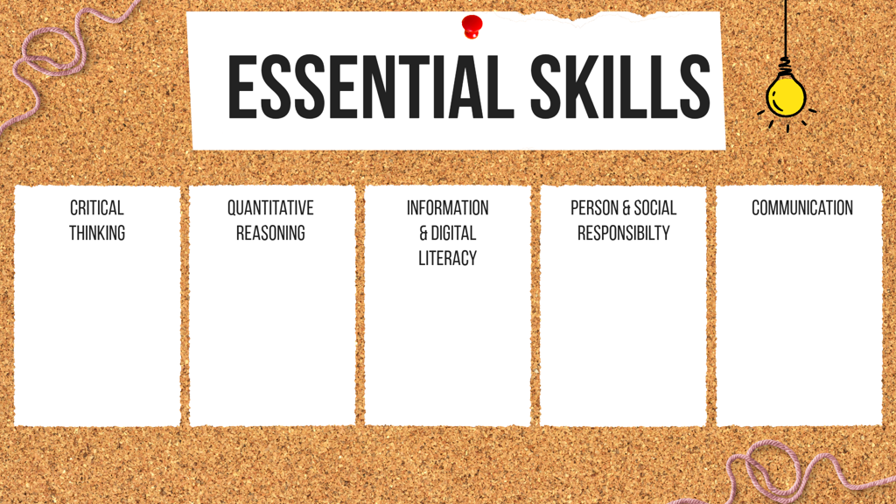

Slide 6
Context
Our teaching is situated as part of a larger community of curriculum and assessment.
Importance of familiarizing with such context at the institutional level to design, implement and inform our teaching practices.
Our teaching starts with assessing what student success looks like to inform how our course will be designed and articulated via activities and assignments.

Slide 7
Curriculum and
Assessment
Course design:
Student
Learning Outcomes
What assessment does
Connections &
Impact
Teaching: Interventions
& Improvements
Alignment:
course assignments
and rubrics

Slide 8
General Education at UNM questions
1
Teaching GenEd at UNM:
Who are those students?
2
UNM GenEd as part of NMHED
What does it mean?
3
UNM GenEd Course syllabus: Existing GenEd courses at UNM have Student Learning Outcomes (SLOs) that have been approved from UNM and NMHED
What are we (course instructors) asked to do?
Where do we begin?

Slide 9
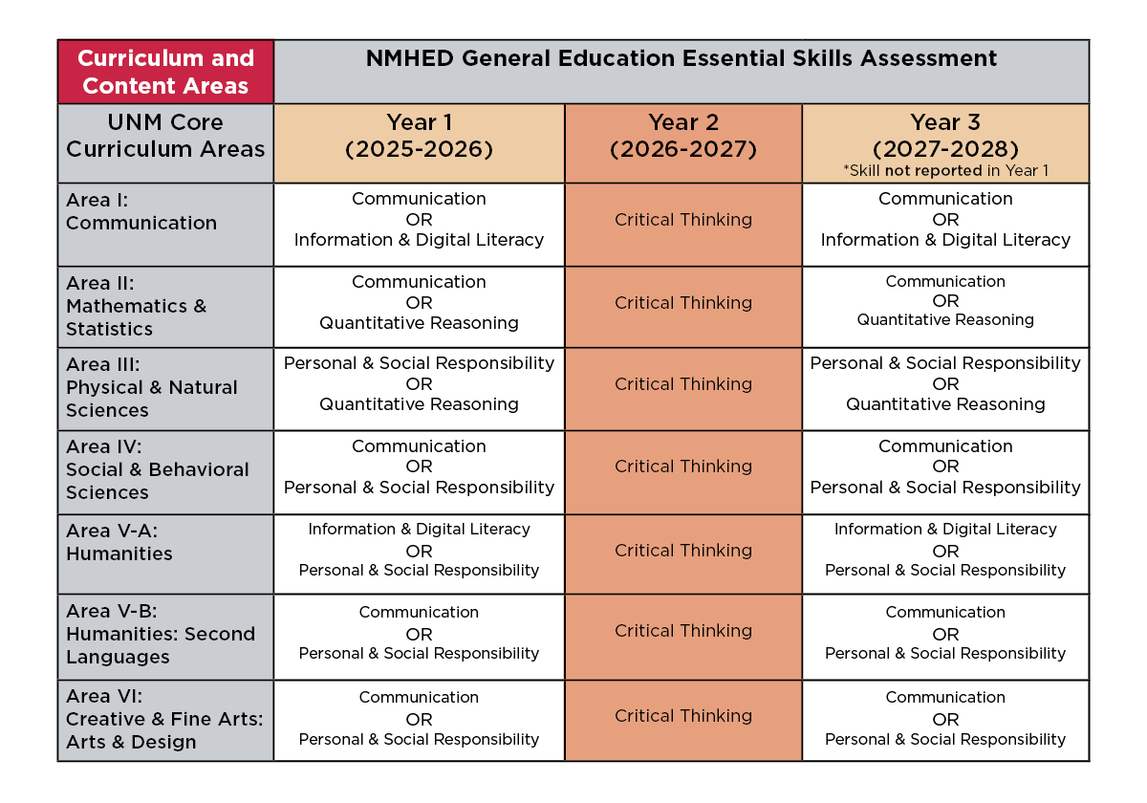
UNM within NMHED

Slide 10
WRITE DOWN THE FOLLOWING INFO
BASED ON THE MATERIAL YOU HAVE COLLECTED
FOR TODAY´S WORKSHOP:
1. ONE UNM GE COURSE. you are currently teaching in Fall 2025/will be in Spring 2026
2. ONE CONTENT AREA (identify your GE course- UNM content areas)
3. THREE ESSENTIAL SKILLS: List the three aligned with your designated content area
Search your course at UNM Office of Registrar 2025-2026 Catalog to confirm which UNM content area your course is part of (look for section called GEN ED AREAS & DIVERSITY)

Slide 11
1. 1000 level courses typically rate at emerging level (rating 1)
2. 2000 level courses typically rate at developing level (rating 2)
3. UNM does see a diverse group of student levels in GE courses which means ratings vary based on student experience and skill levels. Juniors and seniors do take GE courses and may show higher performance than early college learners.
Patterns- GE scoring
(from GE rubrics ratings 1-3)

Slide 12
Rubric alignment exercise Part I
INDIVIDUAL WORK TIME- 10 MIN
Open the GE rubric that you will be aligning with your assignment prompt.
Read all rubric dimensions on the left. Choose which two dimensions best reflect your expectations of student skill building with your assignment. As you are choosing, think of ways you teach this skill and have students practice it before this specific assessment. Then think about the 2 dimensions that you WILL assess for student performance.
Now look at the highlighted areas of your rubric and follow along with our rubric explanations in the next slides.

Slide 13
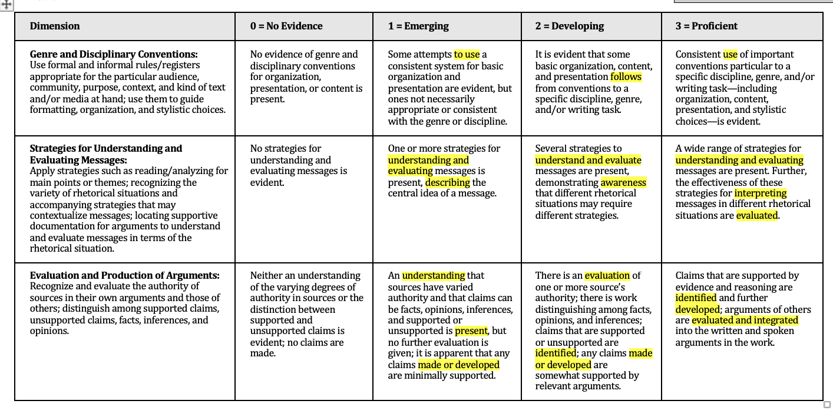

Focus on Developing category (column) and at least 2 dimensions (rows)
This rubric was created using the NMHED Essential Skill Rubrics and the Association of American Colleges and Universities (AAC&U) Written Communication VALUE Rubric.
Retrieved from https://www.aacu.org/value-rubrics
RUBRIC: COMMUNICATION

Slide 14
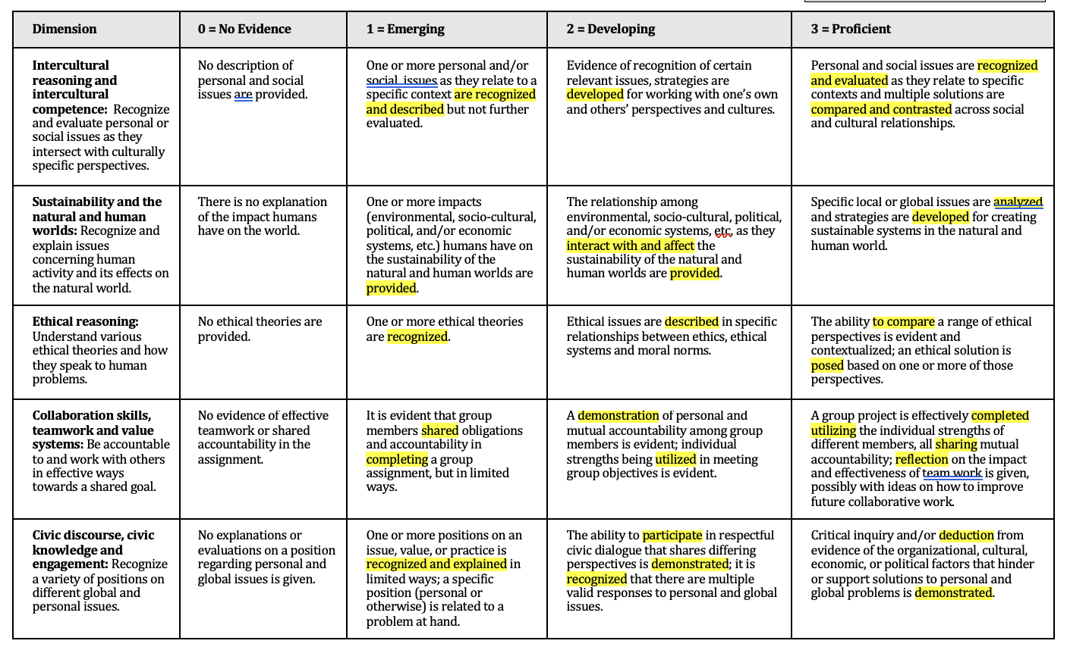

Focus on Developing category (column) and at least 2 dimensions (rows)
This rubric was created using the NMHED Essential Skill Rubrics and the Association of American Colleges and Universities (AAC&U) Written Communication VALUE Rubric.
Retrieved from https://www.aacu.org/value-rubrics
RUBRIC: PERSONAL AND SOCIAL RESPONSIBILITY

Slide 15
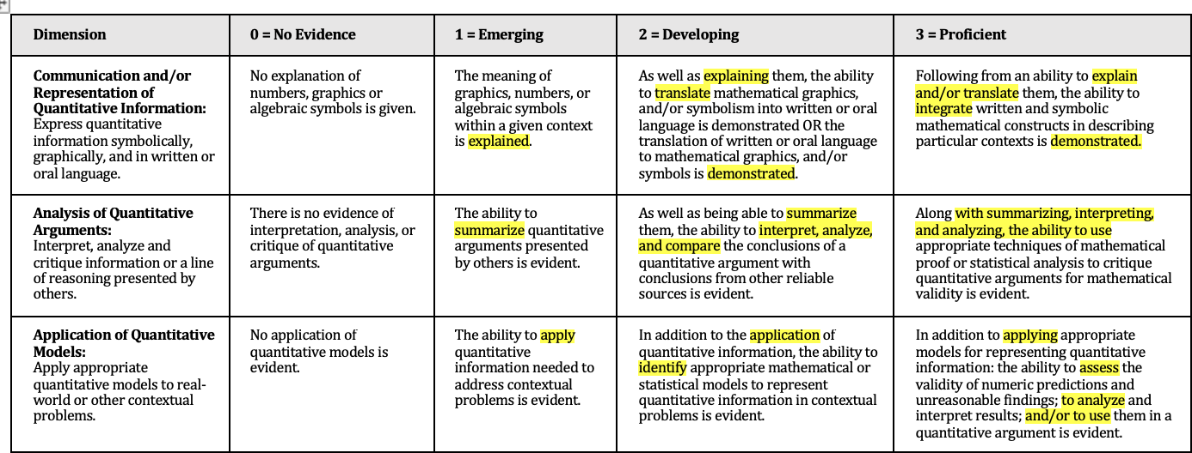

Focus on Developing category (column) and at least 2 dimensions (rows)
This rubric was created using the NMHED Essential Skill Rubrics and the Association of American Colleges and Universities (AAC&U) Written Communication VALUE Rubric.
Retrieved from https://www.aacu.org/value-rubrics
RUBRIC: QUANTITATIVE REASONING

Slide 16
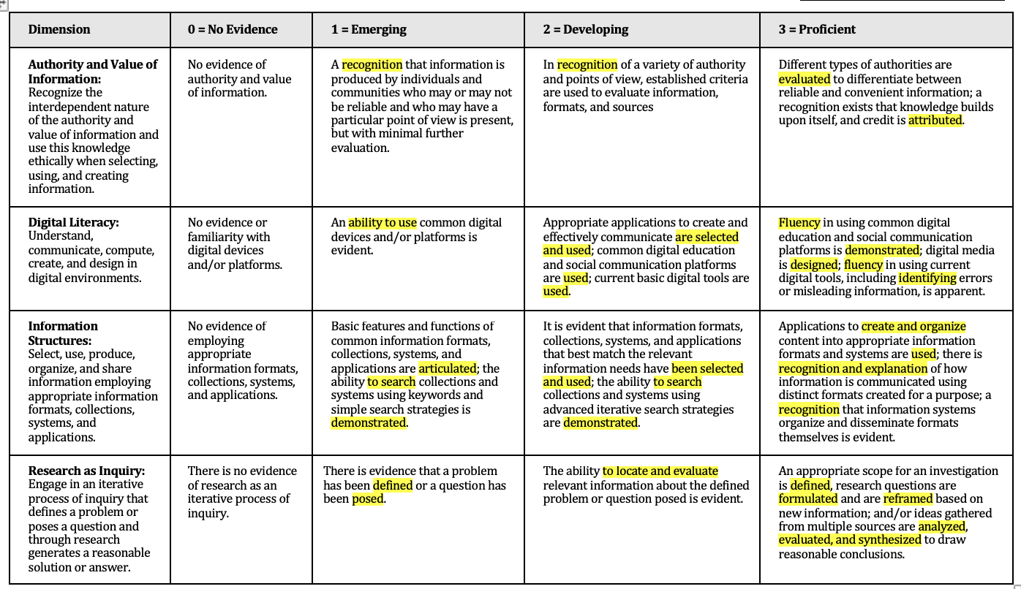

Focus on Developing category (column) and at least 2 dimensions (rows)
This rubric was created using the NMHED Essential Skill Rubrics and the Association of American Colleges and Universities (AAC&U) Written Communication VALUE Rubric.
Retrieved from https://www.aacu.org/value-rubrics
RUBRIC: DIGITAL INFORMATION LITERACY

Slide 17
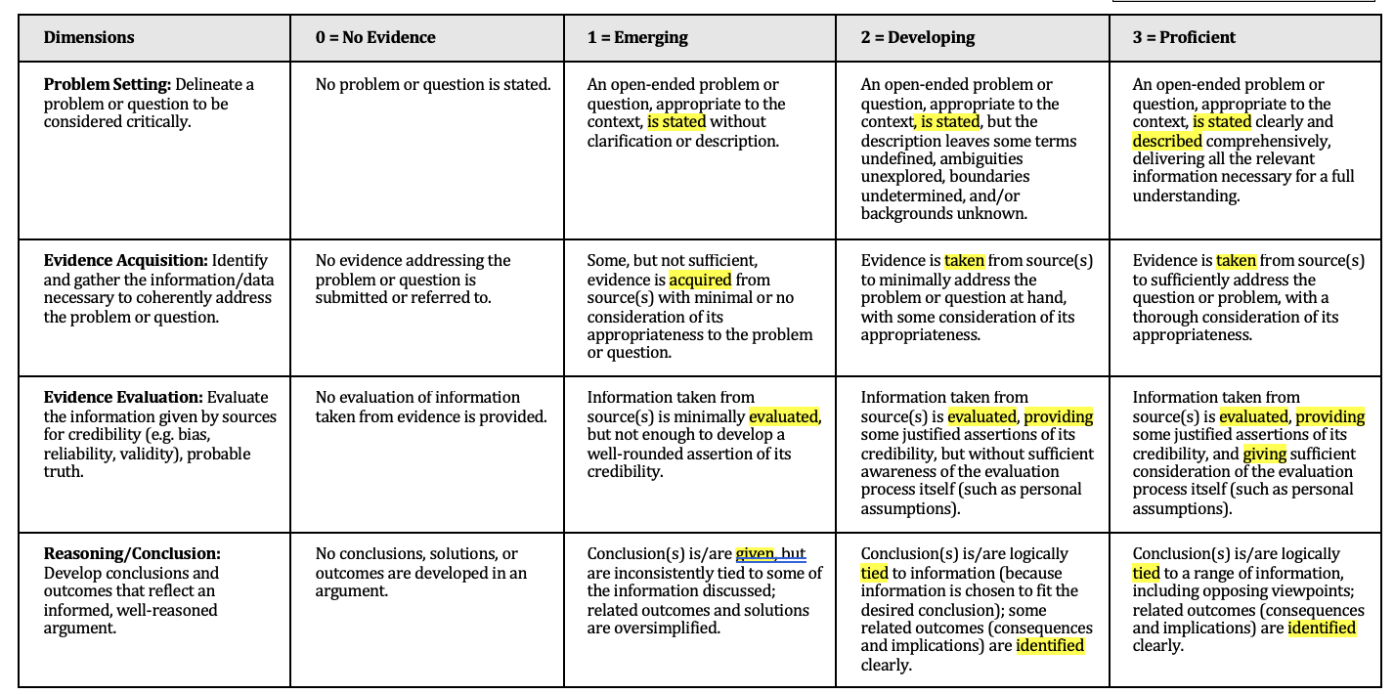
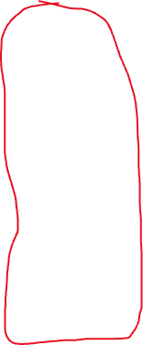
RUBRIC: CRITICAL THINKING
Focus on Developing category (column) and at least 2 dimensions (rows)
This rubric was created using the NMHED Essential Skill Rubrics and the Association of American Colleges and Universities (AAC&U) Written Communication VALUE Rubric.
Retrieved from https://www.aacu.org/value-rubrics

Slide 18
Rubric alignment exercise Part II
Understand the Rubric Scale: Review the two dimensions you've chosen and read the descriptions of what students should demonstrate at each level (1-3). Notice how the expectations increase as the rating goes up.
Determine the Expected Level: Decide what level of performance (1-3) you want your General Education (GE) students to achieve for each dimension. This will help you set clear standards for your assignment.
Align Your Assignment: Once you've chosen the expected level, look at the specific expectations for that level in both dimensions. Use these expectations to design your assignment prompt and ensure it meets your goals.

Slide 19
Mapping exercise
Part III
Your sample assignment related to
essential skill x and its rubric
Review your existing assignment. Does it include specific language on…?:
  The GE essential skill
  Dimension language (specifically the two you selected)
  Appropriate level of student expectations you expect or want them to strive for
Add specific LANGUAGE to your existing assignment prompt that includes the elements listed above in item one.

Slide 20
Final check list
Your GE course SLO is becoming connected with an NMHED essential skill and rubric in your GE content area at UNM.
Your course assignment is becoming connected with course SLOs, an essential skill and rubric.

Slide 21
Making stronger connections (course calendar/schedule)
When will I teach the material?
How will I reinforce the material?
What will students do with the material?
Are students ready for the assessment?
What evidence of learning do I expect?
How do I integrate UNM essential skill and rubric into an assignment grade?
Notes:
When will I teach the material?
Plan out when you'll introduce the content and skills that students will be assessed on.
2. How will I reinforce the material? Think about how you'll review and build on the content and skills throughout the semester.
3. What will students do with the material? Consider how students will apply, understand, and engage with the content and skills.
4. Are students ready for the assessment?
Make sure students have had enough practice and support to perform at the level you'll be assessing them at.
5. What evidence of learning do I expect?
Decide what signs or products will show that students have learned the material (e.g., assignments, quizzes, projects).

Slide 22
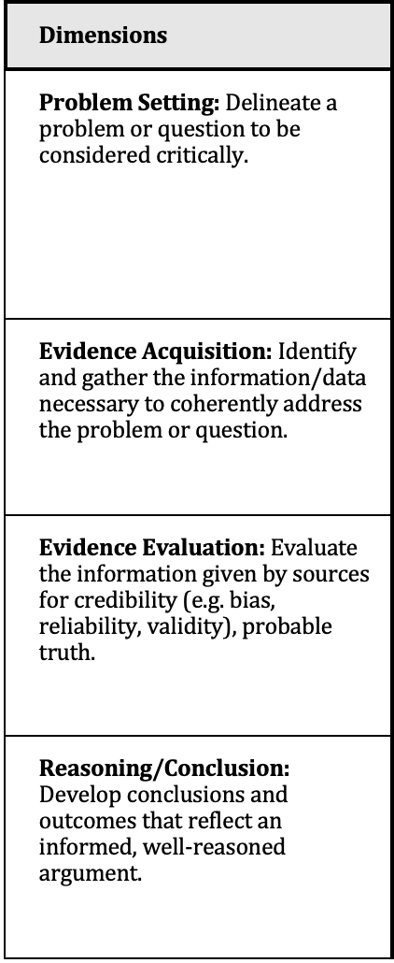
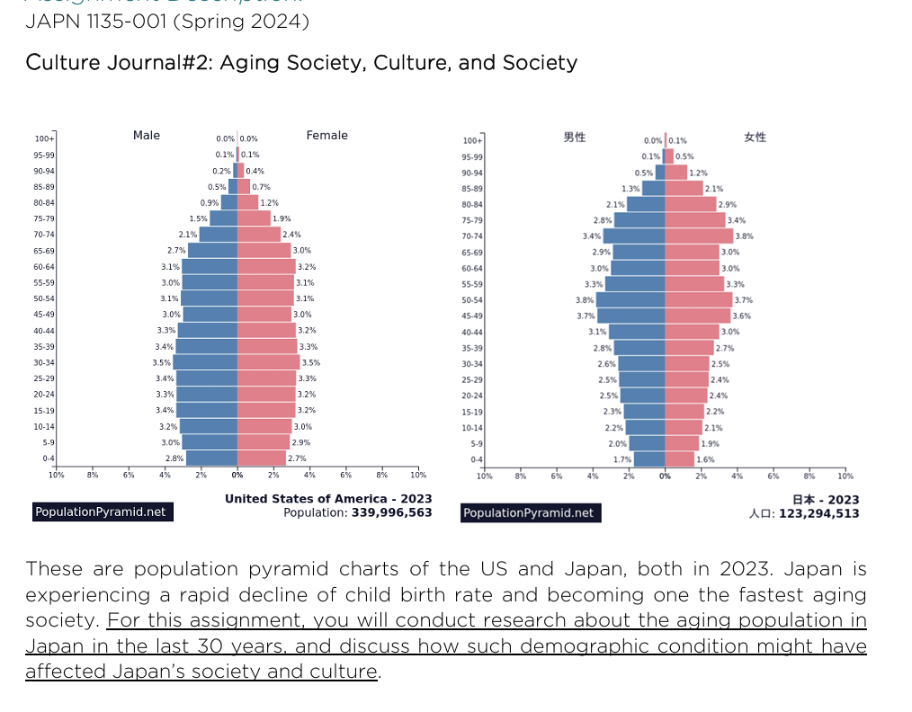
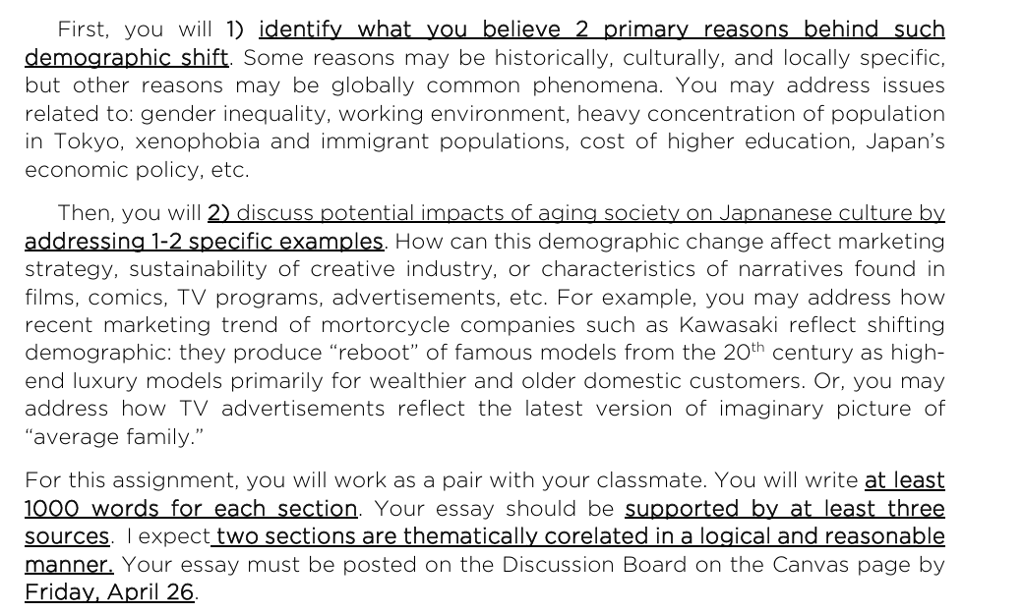
Utilizing UNM essential skill rubric
Sample for Critical Thinking
JAPN 1135- UNM AREA VB
Communication
Critical Thinking
Personal and Social Responsibility

Slide 23
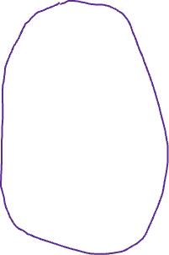
Utilizing UNM CT rubric
 | DOES NOT MEET | APPROACHES (65-75 points) | MEETS Expectations (77-89 points) | EXCEEDS (90-100 points)
Problem Setting 25% |  | 16-21 Identifies one primary reason but does not clearly identify or explain two primary reasons. | 19-22 States two primary reasons but explanation lacks depth or clarity. | 23-25 Clearly identifies and explains two primary reasons for Japan's demographic shift.
Evidence Acquisition 30% |  | 19-22 Incorporates two credible or relevant sources | 23-26 Incorporates at least three sources, but they may not be credible or relevant. | 27-30 Incorporates at least three credible sources that provide strong evidence.
Evidence Evaluation 25% |  | 16-21 Does not thoroughly evaluate evidence or uses it to support weak arguments. | 19-22 Evaluates evidence, but analysis may lack depth or clarity. | 23- 25 Thoroughly evaluates evidence and uses it to support logical arguments about potential impacts.
Reasoning/Conclusion 20% |  | 13-14 Two sections are present but lack coherence | 15-17The two reasons are somewhat correlated but may not be clear and cohesive. | 18-20 The two reasons are thematically related in a logical and reasonable manner, demonstration a clear and cohesive argument
Overall score: _______/100 points |  | Note: | Note: | Note:

Slide 24



GenEd Resources for you as instructors
Gen Ed Assessment at UNM
GenEd Assignment Sample Collection
GenEd Essential Skill Rubrics
CONTACT US (JULIE & EVA)
@ ASSESS@UNM.EDU

